Slide 1
Thermostat
Projects and laboratory on communication systems 2018/2019
Students:
Paolo Calao, Samuele Yves Cerini, Federico Pozzana
1

Slide 2
Outline
Introduction
GUI and User Experience
Welcome Window
System Settings
Room Functionalities
Program timetable Definition
Backend SW and Web Interface
Web interface
RPi core logic
RPi Database manager
RPi Connection manager
Hardware
Motivations
Example of compliance
Types of ESPs
MQTT Topic
2

Slide 3
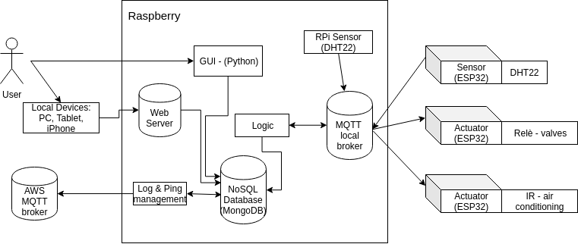
Introduction – A Top-Down Approach
GUI and UX
Backend SW Logic
External Devices
3

Slide 4
GUI and User Experience
Goal: provide a simple but functional interface for the end user
How: functionalities over fancyness, easy of use is a top priority
What we provide:
An On-Board Graphical User Interface (PyQT5 Framework)
A Web User Interface accessible from the home Local Network
4

Slide 5
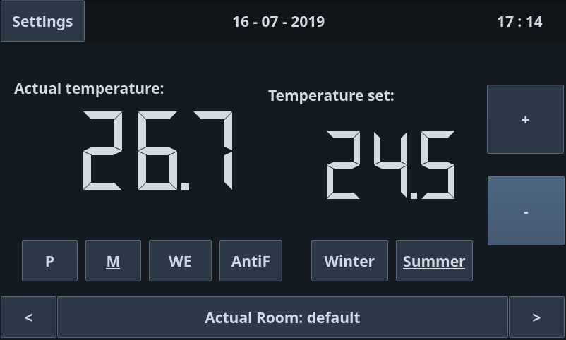
Welcome Window
Available Modes:
Programmable
Manual
WeekEnd
AntiFreeze
Seasons:
Winter
Summer
Room Slideshow
The welcome window changes dinamically following the Actual Room displayed
5

Slide 6
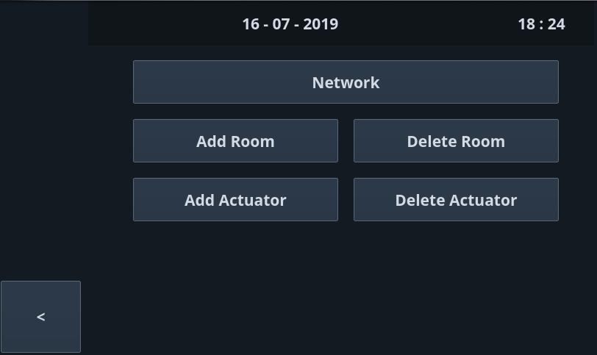
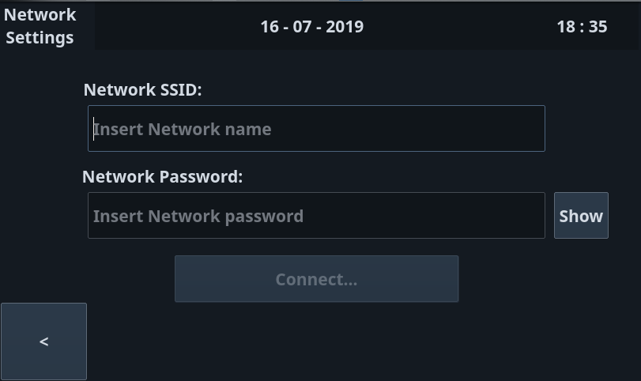
System Settings
Network:
Connection to Home WiFi network
SSID + Password
Linux tools: wpa_supplicant, iw, ping
Room:
Add/Delete Room
Mnemonic (ex. "Kitchen")
Deleting a room will logically delete all actuators and valves connected to it
Actuator:
Unique ID
An Actuator will be connected to valves that will handle the heating pipes
6

Slide 7
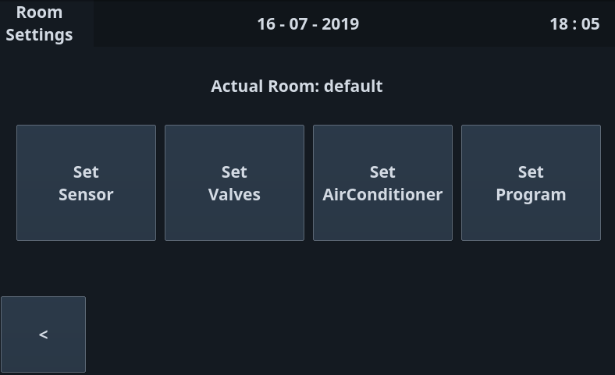
Room Functionalities
Sensor:
Collects temperature for the actual room
Temperature is displayed in Welcome Window
Valves:
An Actuator will drive a set of valves
Valves will be turned on/off iff "Winter" mode is activated
AirConditioner:
Module used to drive an AirConditioner, iff "Summer" mode is activated
IR Blaster
Program
Timetable definition
7

Slide 8
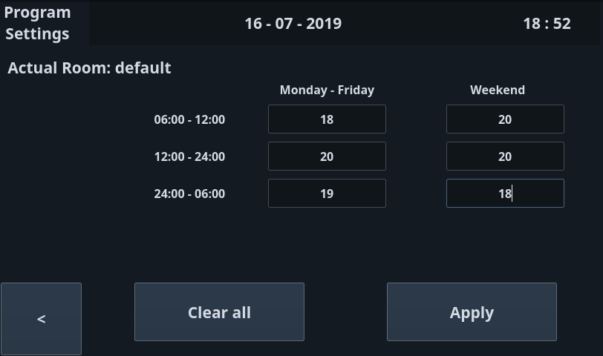
Program Timetable Definition
Program:
Working Days + Weekend
Morning Temperature
Evening Temperature
Night Temperature
Program is activated iff "Program" Mode is enabled
8

Slide 9
Web Interface
Web interface reachable from devices in the same local network of the Raspberry.
It allows the customer to monitor temperatures and setup, and to change rooms settings. Also some graphs are shown.
Server-Side
M-DNS allow the access to the web Interface using the hostname ‘http://thermostat.local’
Apache2 + PHP
REST API to access thermostat status, configuration and temperatures.
Client-Side
Javascript framework called AngularJS
Single page application, only data structures are reloaded
9

Slide 10
RPi core logic
Central component of the system, gives life to devices interactions
Retrieve all temperature messages
Decides which actuator must be driven their working mode
Raspberry
Core Logic
Actuator 1
Storage
(DB manager)
Connection Manager
Actuator 2
Sensor 1
Needs a communication channel, in order to control the flow of messages
Needs a Storage to save and retrieve interesting informations
10

Slide 11
RPi Database Manager
Common source of interesting informations for every component of the system
Informations always updated and shared, race conditions avoided
NoSQL DB stores informations in documents, format used to send messages. No data manipulation needed.
GUI
DB
Web Interface
Database Manager
Core Logic
11

Slide 12
RPi Connection Manager
MQTT protocol adopted to allow devices communication
MDNS is exploited in order to make the raspberry reachable from its local net
The MQTT broker resides in the RPi, Mosquitto was used
Raspberry
Local network
MQTT broker
Actuator 1
Connection Manager
Actuator 2
Sensor 1
Connection Manager component is used by the logic for subscribing/publishing
12

Slide 13
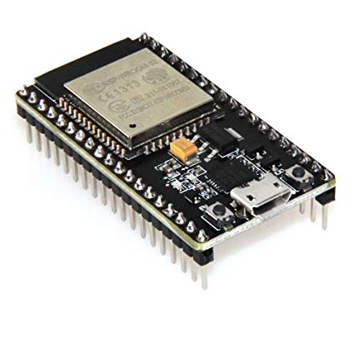
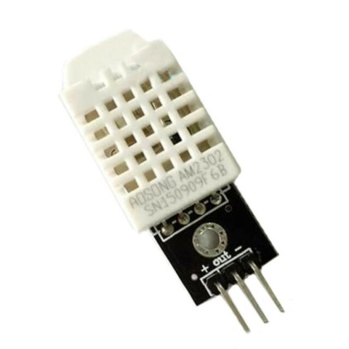
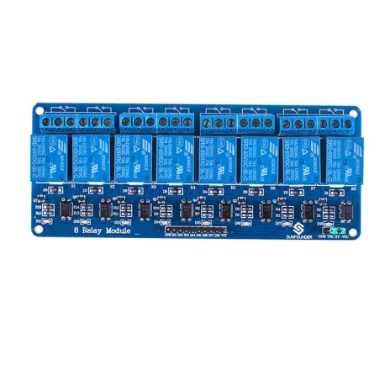
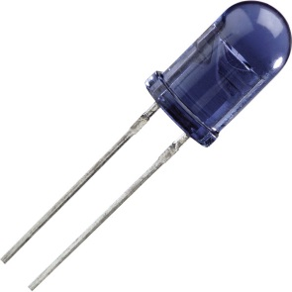
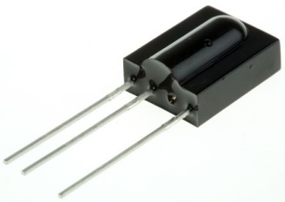
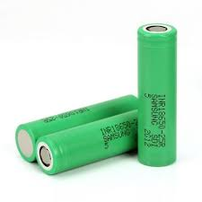
Hardware used
ESP32 board
DHT22 temperature sensor
Relè module
IR transmitter and receiver
Li-Ion batteries and relative circuit
13

Slide 14
Motivations
All the components used in this project respect this requirements
Availability among group members
Availability of libraries on the intenet (see DHT22)
In any case all the components had to be compliant with the project specifications
14

Slide 15
Example of compliance
Project specification : Temperature must be controlled in the range from -10 °C up to +40 °C with an accuracy of 0,5 °C
DHT22 accuracy and range : 0.5 °C accuracy, range -40 °C up to 80 °C
DHT11 accuracy and range : 1 °C accuracy, range 0 °C up to 50 °C
Our choice was the DHT22 due to the previous reasons
15

Slide 16
Types of ESPs
ESP used as sensor : this ESP uses the DHT22 to sense the current temperature, it publishes the result on the topic "temperatures"
ESP used as valve actuator : this ESP is connected to the relay module, it is firstly subscribed to the topic "actuator/configuration" where it is informed about the corrispondance between a valve and a room, and then it is dynamically subscribed to the topic "actuator/hot/roomID" where room ID is a number which describe the room/rooms currently configured
ESP used as IR actuator : this ESP is connected to both IR transmitter and IR receiver, it is dynamically subscribed to the topic "actuator/cold/roomID" where room ID is a number which describe the room in which the ESP is linked to
16

Slide 17
MQTT topic used
Each ESP32 subscribe/publish to different topic depending on its function
ESP32 as sensor : publish on topic temperatures
ESP32 as IR actuator : subscribed to topic actuator/cold/roomID
ESP32 as valve actuator : subscribed to topic actuator/configuration and actuator/configuration/roomID
17

Slide 18
Thanks for the attention

